Slide 1


Hugging Face & Machine Learning: Empowering Developers
Unlocking the Power of Pre-trained Models and Open-Source Ecosystem

Slide 2
Who am I ?
Pierre Snell : ierezell@gmail.com
Senior Data Scientist

Slide 3




Agenda
Introduction to Hugging Face & Machine learning
The Hugging Face Ecosystem
tools… library… etc…
Hands on Practical Developer Uses &
Roadmap for you

Slide 4



Introduction
Machine learning is transforming modern development by enabling intelligent applications.
Pre-trained models have made it easier for developers to create powerful solutions.
Hugging Face democratizes access to state-of-the-art AI, making it accessible for everyone.

Slide 5



What is Hugging Face?
AI company
Open-source
Community
Transformers library
Hub
Accessible tools
Build and deploy models

Slide 6

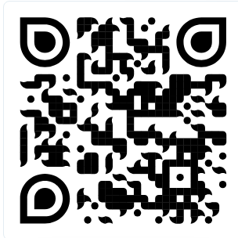
The Hugging Face Ecosystem
Transformers Library: Open-source package for NLP, computer vision, and audio tasks.
https://huggingface.co/
Notes:
Go to https://huggingface.co/ for a quick tour

Slide 7

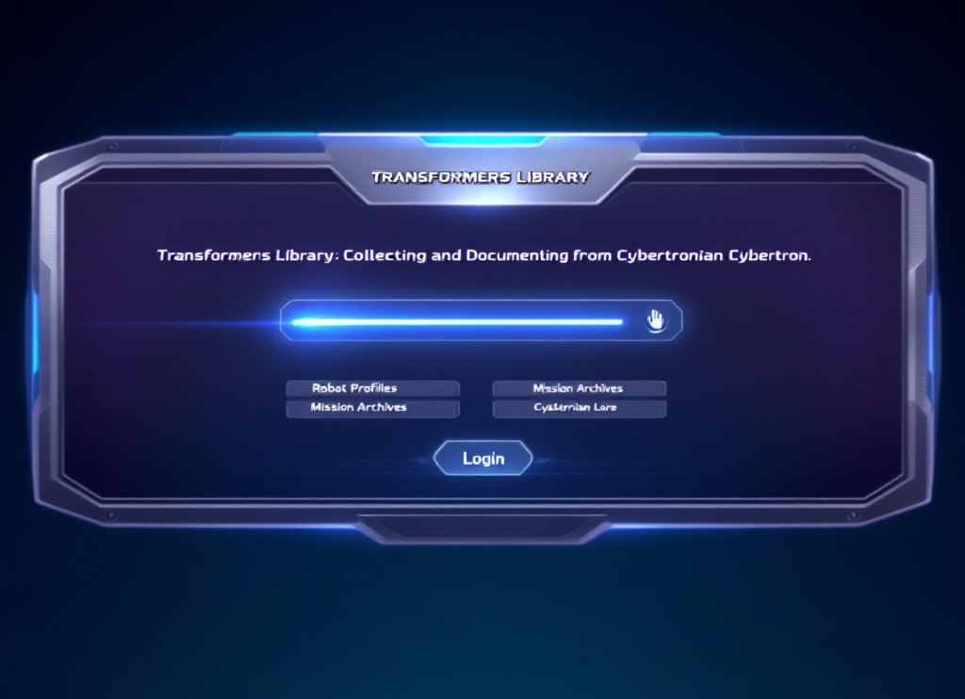

Deep Dive: Machine learning
The Transformers & Cie Library allows easy access to state-of-the-art models like ChatGpt, MusicGen, ViT, YOLO.
It features pre-trained models, transfer learning, and a simple API for quick implementation.
Notes:
explain briefly the differences in machine learning, ask question to the public

Slide 8


The Hugging Face Hub
The Hub is a Git-based platform for hosting models and datasets, facilitating collaboration among developers.
It accelerates innovation and reduces time-to-market for AI applications.
Datasets / Spaces / Gradio / Posts / Docs / Forum / Cloud (computing / Training)...

Slide 9
Developer Tools & Integrations
Hugging Face API & Libraries
Demo Platforms Gradio for interactive demos.
Community & Support:
documentation and active community.
Notes:
Hub : Host Git-based models, datasets, and Spaces on the HF Hub
Hub Python Library: Python client to interact with the Hugging Face Hub
Huggingface.js : JavaScript libraries for Hugging Face with built-in TS types
Tasks: Explore demos, models, and datasets for any ML tasks
Dataset viewer: API for metadata, stats, and content of HF Hub datasets
Core ML Libraries
Transformers : State-of-the-art ML for PyTorch, TensorFlow, JAX
Diffusers : State-of-the-art Diffusion models in PyTorch
Datasets: Access & share datasets for any ML tasks
Transformers.js: State-of-the-art ML running directly in your browser
Tokenizers: Fast tokenizers optimized for research & production
Evaluate: Evaluate and compare models performance
timm State-of-the-art vision models: layers, optimizers, and utilities
Sentence Transformers: Embeddings, Retrieval, and Reranking
Training & Optimization:
PEFT: Parameter-efficient finetuning for large language models
Accelerate: Train PyTorch models with multi-GPU, TPU, mixed precision
Optimum: Optimize HF Transformers for faster training/inference
AWS Trainium & Inferentia: Train/deploy Transformers/Diffusers on AWS
TRL: Train transformers LMs with reinforcement learning
Safetensors: Safe way to store/distribute neural network weights
Bitsandbytes: Optimize and quantize models with bitsandbytes
Lighteval: All-in-one toolkit to evaluate LLMs across multiple backends
Deployment & Inference
Inference Providers: Call 200k+ models hosted by our 10+ Inference partners
Inference Endpoints (dedicated): Deploy models on dedicated & fully managed infrastructure on HF
Amazon SageMaker: Train/deploy Transformers models with SageMaker/HF DLCs
Text Generation Inference: Serve language models with TGI optimized toolkit
Text Embeddings Inference: Serve embeddings models with TEI optimized toolkit
Collaboration & Extras: Gradio
Build ML demos and web apps with a few lines of Python
smolagents: Smol library to build great agents in Python
AutoTrain: AutoTrain API and UI for seamless model training
Chat UI: Open source chat frontend powering HuggingChat
Leaderboards: Create custom Leaderboards on Hugging Face
Argilla: Collaboration tool for building high-quality datasets
Distilabel: Framework for synthetic da

Slide 10


Real-World Use Cases & Demos
Sentiment Analysis: Classify text as positive or negative.
Image (HF, Fal.ai, midjourney, etc…)
Text (HF,chatgpt, clouds, etc…)
Audio (HF, clouds, etc…)
Notes:
Ask to the public why narrow model and not only chatgpt. Small demo on laptop.

Slide 11
Getting Started
Explore the Documentation: Visit Hugging Face Docs.
Try the Hugging Face Course: Free online course on transformers.
Join the Community: Engage in forums and Discord channels.

Slide 12
Business & Developer Benefits
Rapid Prototyping: Quickly build applications with pre-trained models.
Cost-Effective: Reduce costs with open-source solutions.
Collaboration: Benefit & learn from a vibrant open-source community.

Slide 13
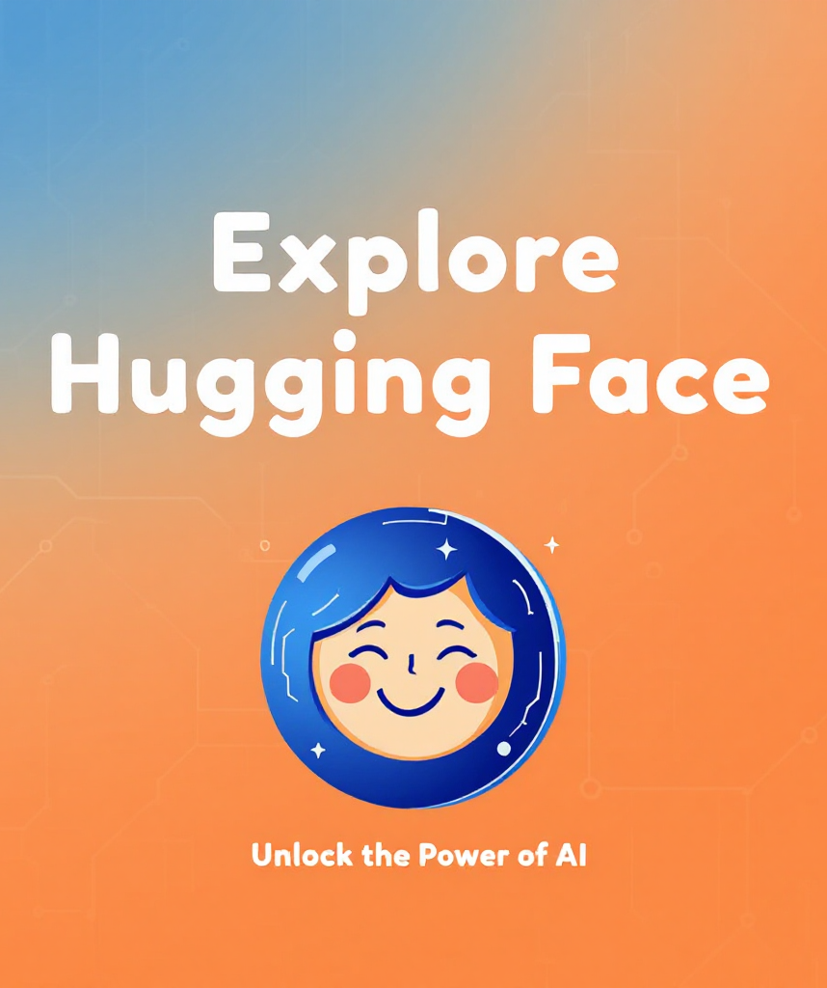
Conclusion & Call to Action
Hugging Face empowers developers to create advanced ML applications through a community-driven platform.
Visit huggingface.co to explore models and demos today!

Slide 14

Q&A
Notes:
No not only python.
Yes multiple use-cases with more knowledge.

Slide 15

Thank You!
Thank you for your attention!
We appreciate your interest in Hugging Face and machine learning.

